Slide 1
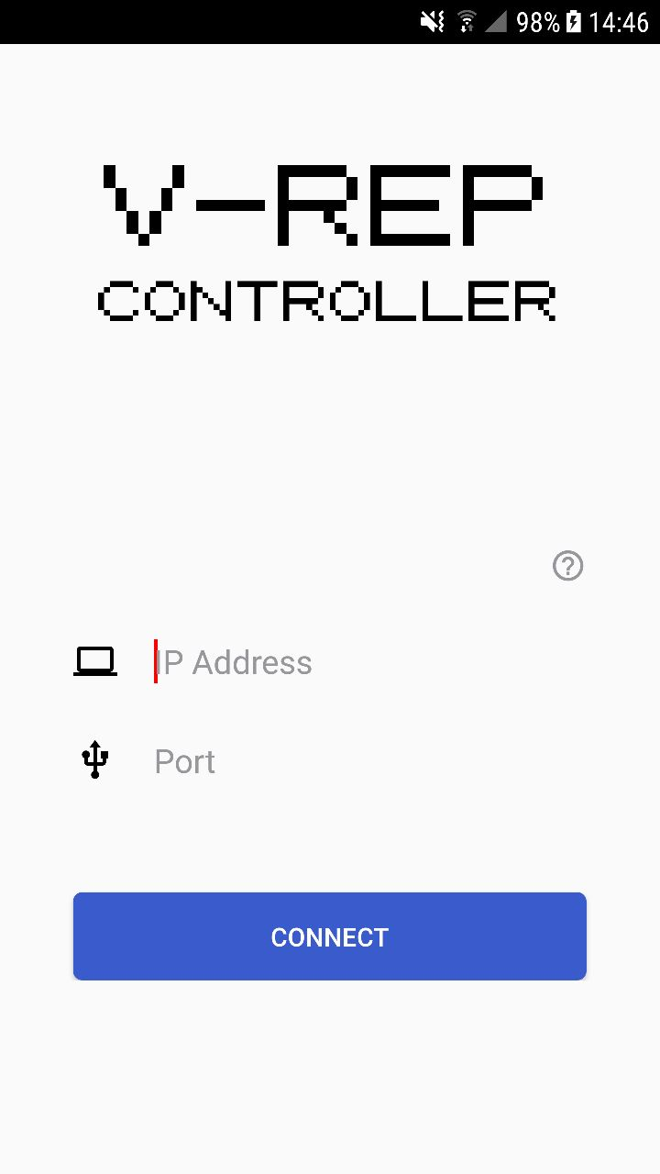

Slide 2
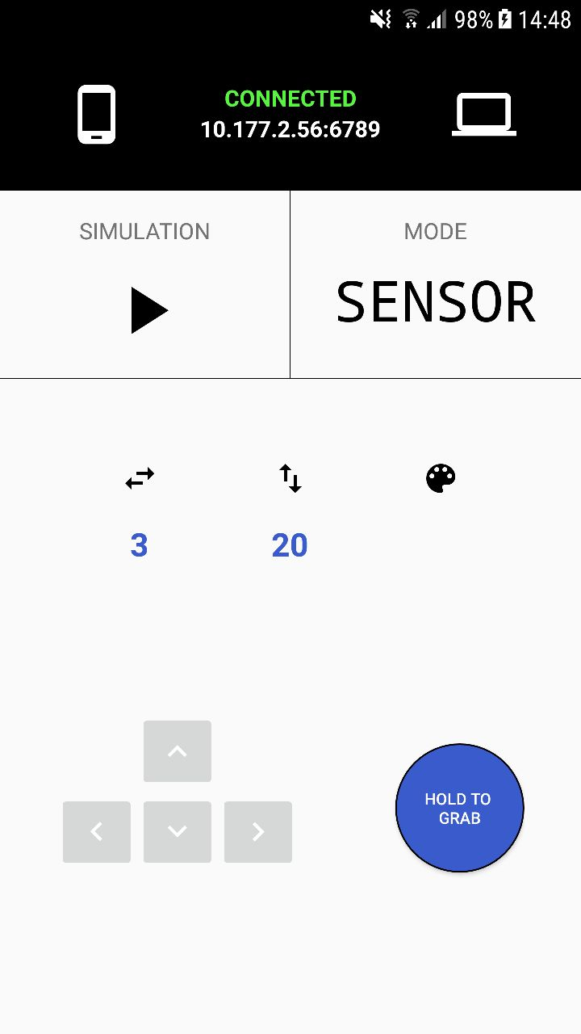

Slide 3
Android Sensors
Accelerometer
Gyroscope
Rotation Vector

Slide 4
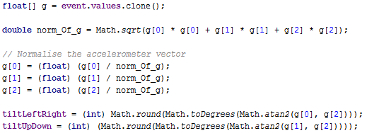
Android Sensors
Accelerometer
Available in virtually all devices
Uses much less battery than the gyroscope

Slide 5
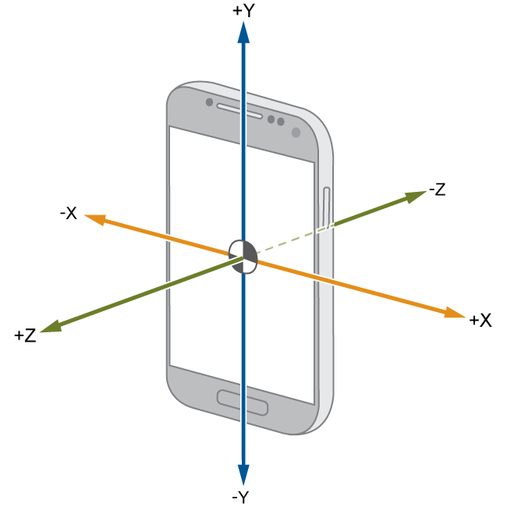

Slide 6


Slide 7
